Slide 1
What is a classic?
Lecture 3

Slide 2
Review
Art (Artist)/ (Handi)crafts (Artisan) / Popular Art (Performer)
High Culture vs. Low Culture
Highest truth becomes a luxury
This impoverishes both
Disciplinary split between skills and theory also has to do with colonial modernity

Slide 3
Classic and Canon
What is a classic?
intrinsic value independent of other considerations

Slide 4
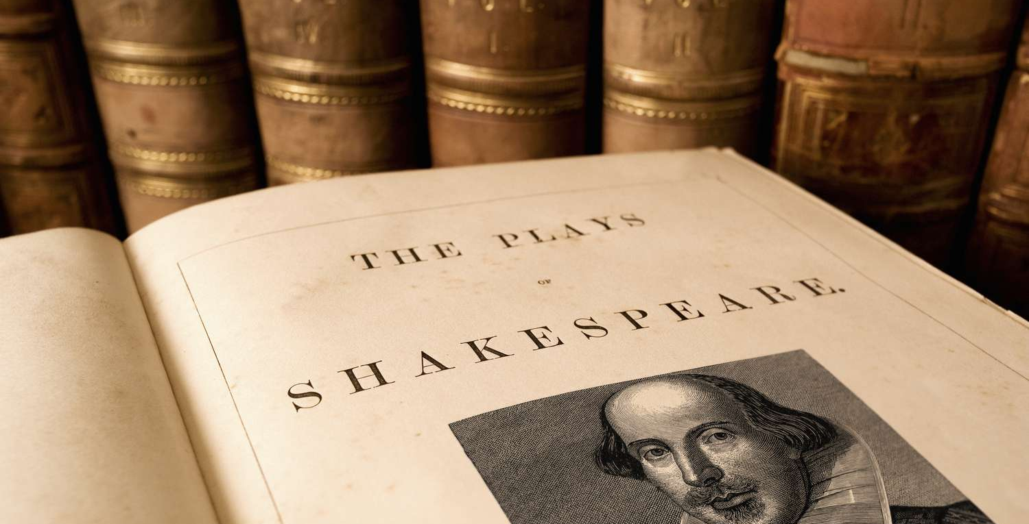

Slide 5
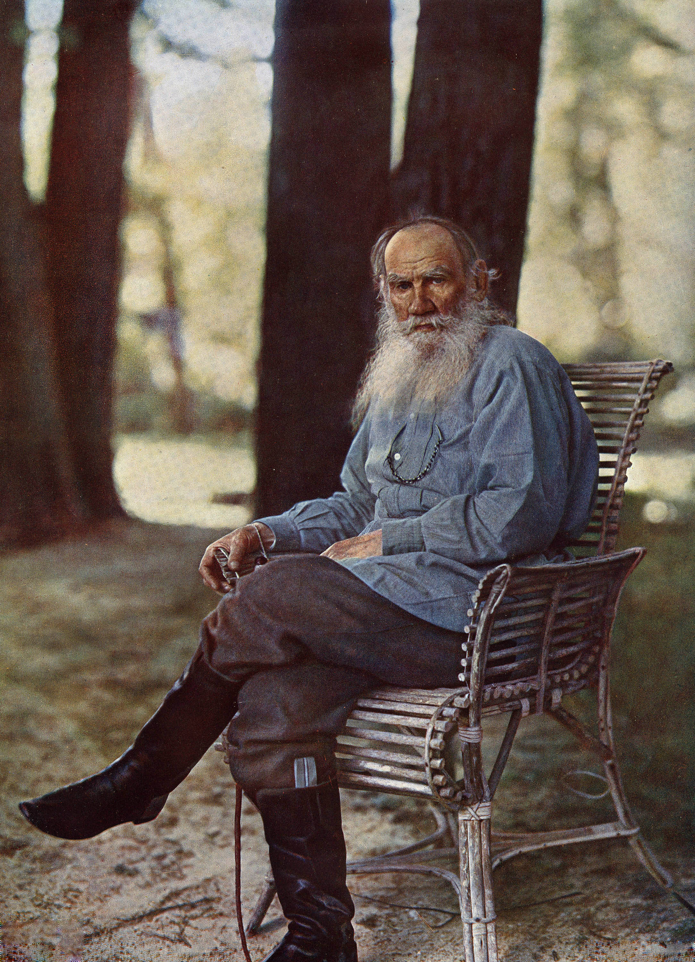
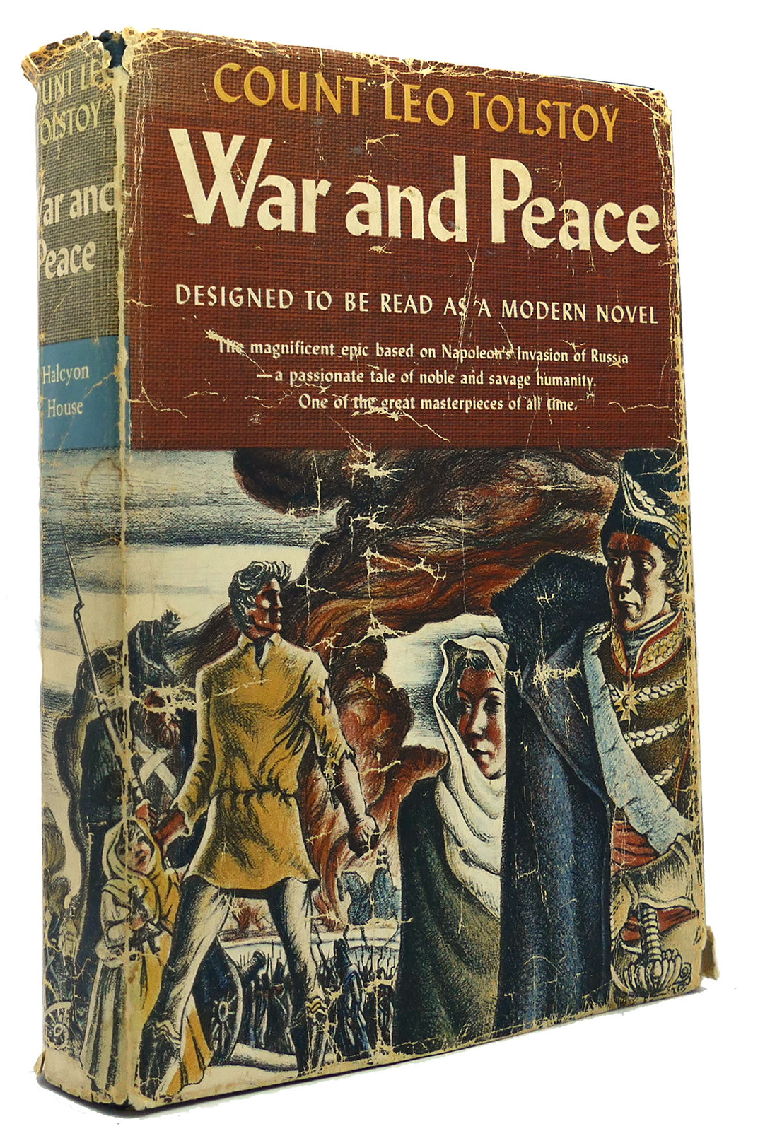

Slide 6
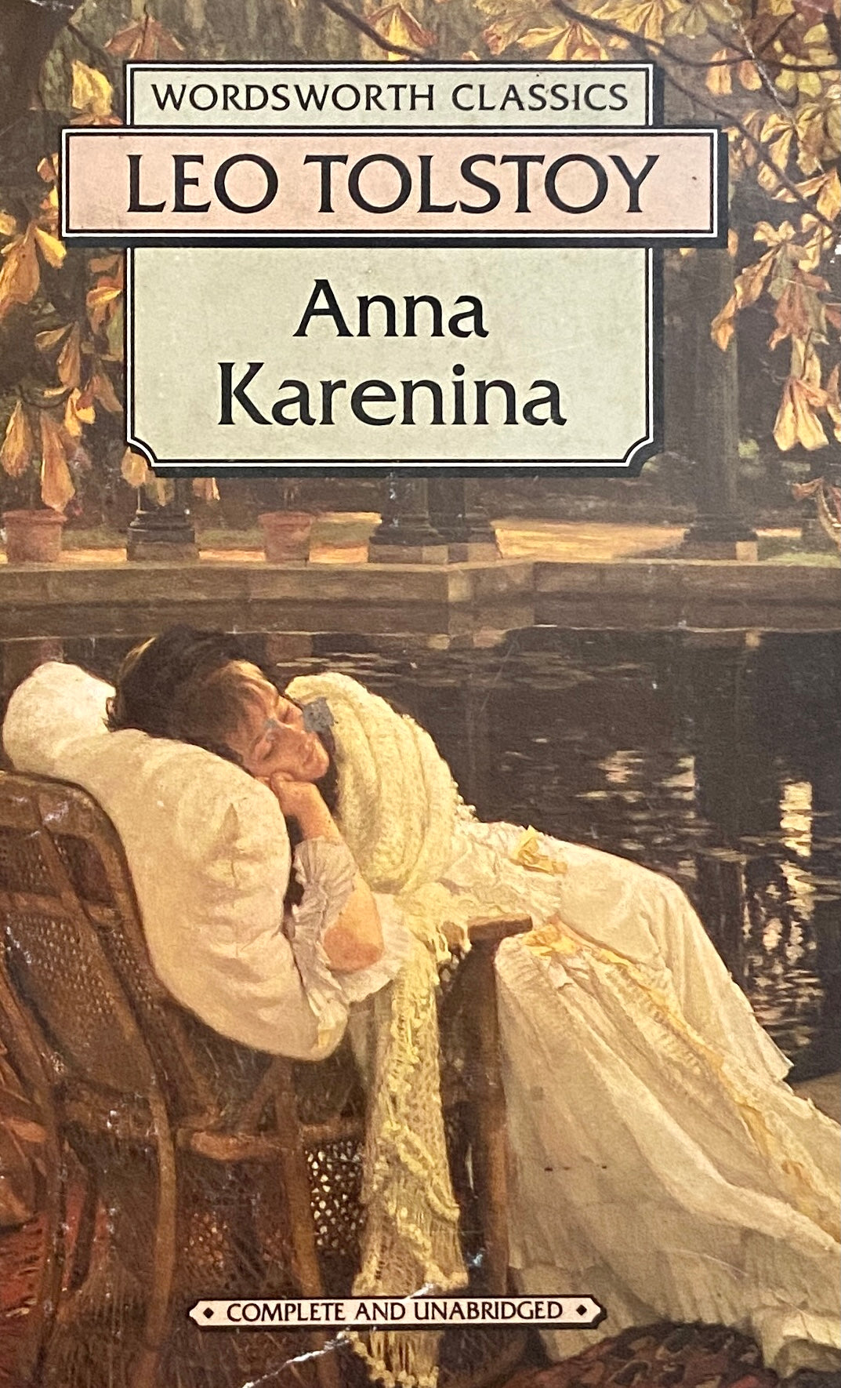

Slide 7
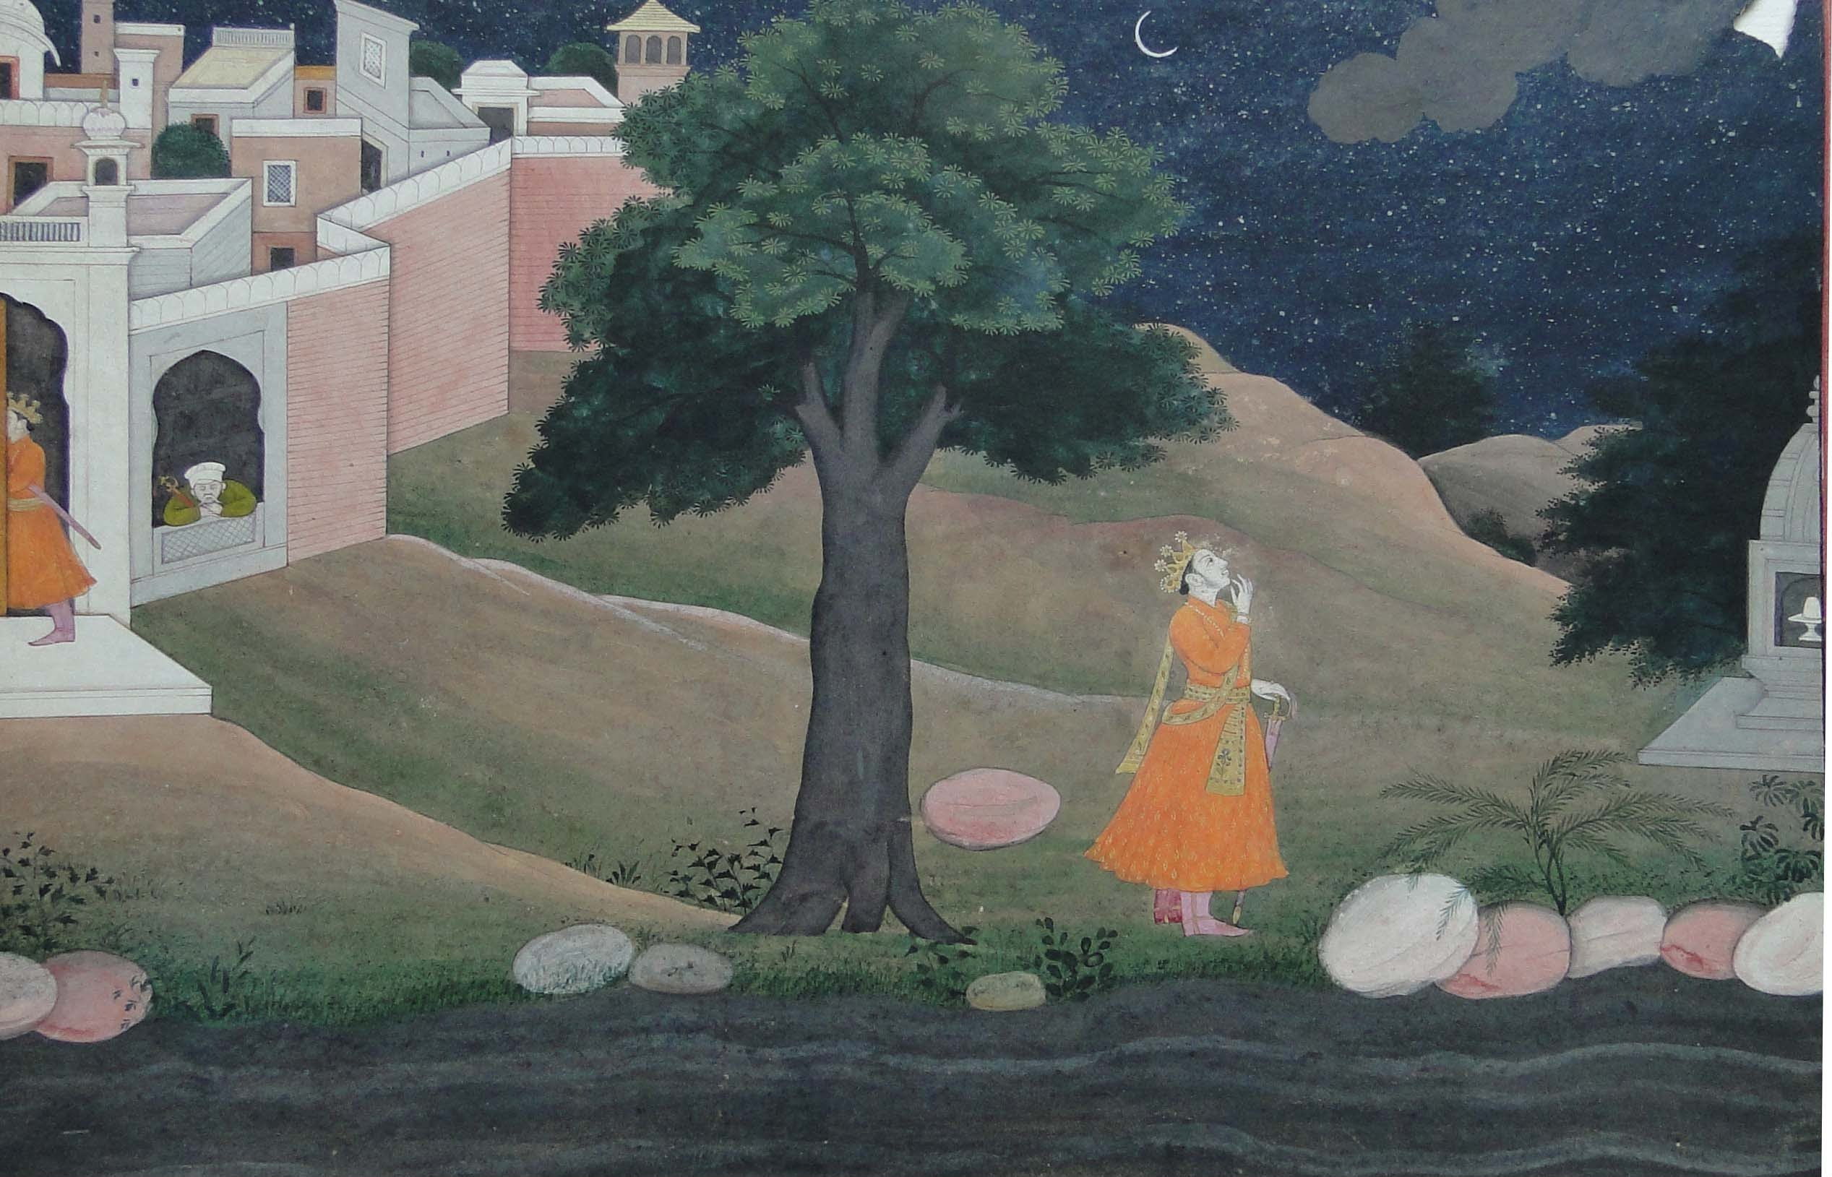
Kalidasa,
Meghduuta
Pahari Painting Guler School c. 1800, Lahore Museum

Slide 9
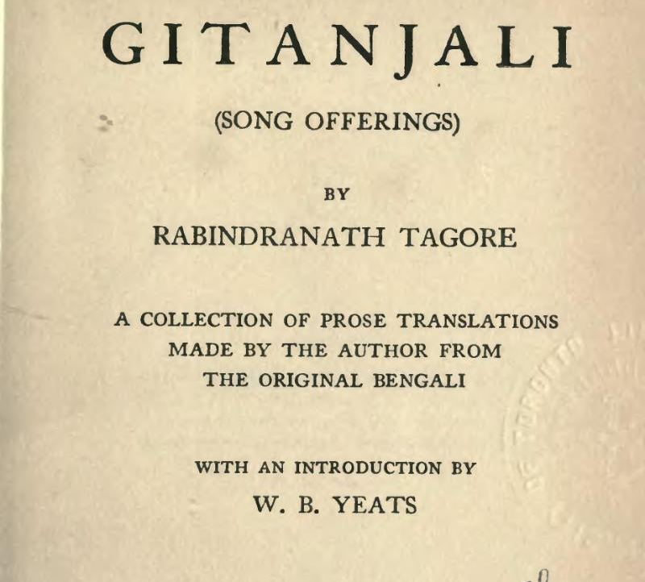
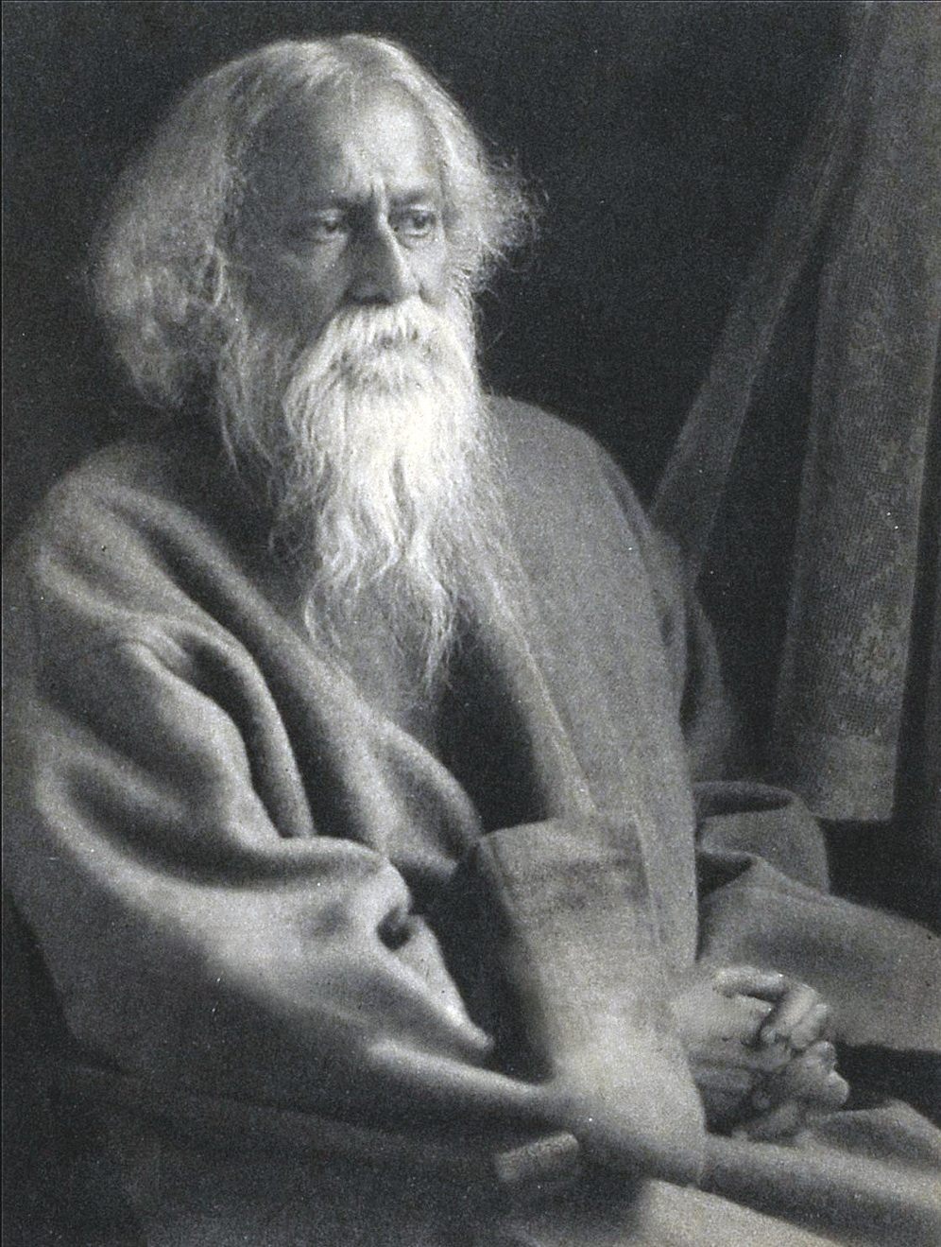

Slide 10
Classic and Canon
What makes a classic a classic?
Is it its internal qualities or are we trained to consider them thus?
The written text, as a manifestation of culture, is embedded in social and historical processes.
The place of “classics” is established in the context and values of a particular age.
Nothing is above the scholar’s critical lens. Everything must be subjected to the same scrutiny.

Slide 11
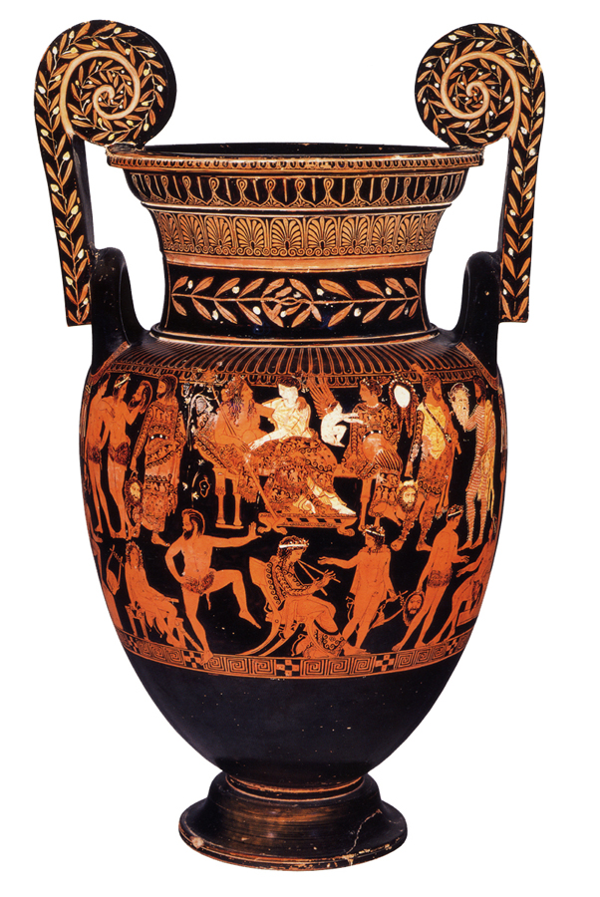
What makes a classic a classic?
Representation
Language
Context of contemporary production, consumption, circulation, distribution
Example: ancient Greek plays
Pronomos Vase (c. 400 BCE)
Museo Archeologico Nazionale di Napoli

Slide 12
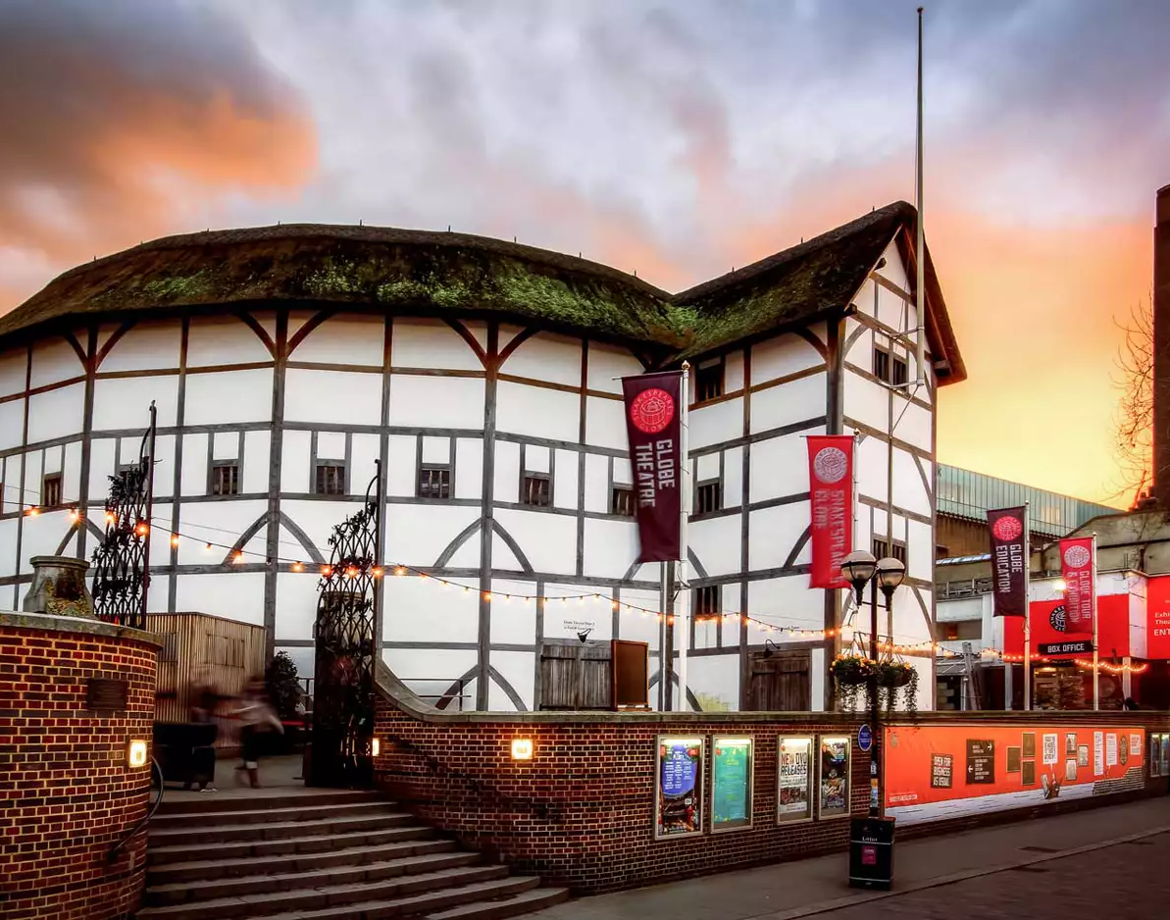
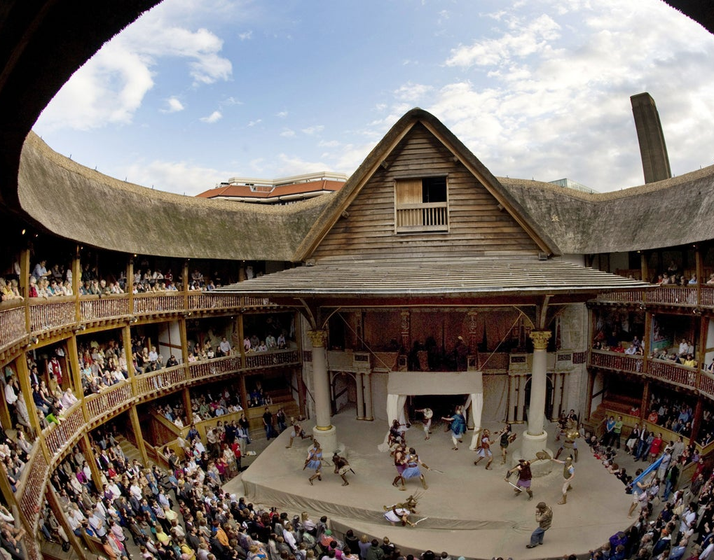
What makes a classic a classic?
Status of drama in Shakespeare’s time

Slide 13
Canon
How is a canon formed?
English literature departments and the colonial project
Literature as a field (discipline/domain) of study is created to execute the ends of the colonial project

Slide 14
Macaulay’s Minute on Education (1835)
“I have no knowledge of either Sanscrit or Arabic. But I have done what I could to form a correct estimate of their value. I have read translations of the most celebrated Arabic and Sanscrit works. I have conversed, both here and at home, with men distinguished by their proficiency in the Eastern tongues. I am quite ready to take the oriental learning at the valuation of the orientalists themselves. I have never found one among them who could deny that a single shelf of a good European library was worth the whole native literature of India and Arabia. The intrinsic superiority of the Western literature is indeed fully admitted by those members of the committee who support the oriental plan of education.”

Slide 15
“How then stands the case? We have to educate a people who cannot at present be educated by means of their mother-tongue. We must teach them some foreign language. The claims of our own language it is hardly necessary to recapitulate. It stands pre-eminent even among the languages of the West. It abounds with works of imagination not inferior to the noblest which Greece has bequeathed to us, -- with models of every species of eloquence, -- with historical composition, which, considered merely as narratives, have seldom been surpassed, and which, considered as vehicles of ethical and political instruction, have never been equaled -- with just and lively representations of human life and human nature, -- with the most profound speculations on metaphysics, morals, government, jurisprudence, trade, -- with full and correct information respecting every experimental science which tends to preserve the health, to increase the comfort, or to expand the intellect of man …”

Slide 16
“… Whoever knows that language has ready access to all the vast intellectual wealth which all the wisest nations of the earth have created and hoarded in the course of ninety generations. It may safely be said that the literature now extant in that language is of greater value than all the literature which three hundred years ago was extant in all the languages of the world together. Nor is this all. In India, English is the language spoken by the ruling class. It is spoken by the higher class of natives at the seats of Government. It is likely to become the language of commerce throughout the seas of the East. It is the language of two great European communities which are rising, the one in the south of Africa, the other in Australia, -- communities which are every year becoming more important and more closely connected with our Indian empire. Whether we look at the intrinsic value of our literature, or at the particular situation of this country, we shall see the strongest reason to think that, of all foreign tongues, the English tongue is that which would be the most useful to our native subjects.”

Slide 17
“[I]t is impossible for us, with our limited means, to attempt to educate the body of the people. We must at present do our best to form a class who may be interpreters between us and the millions whom we govern, -- a class of persons Indian in blood and colour, but English in tastes, in opinions, in morals and in intellect.”

Slide 18
English Literature in India
Departments of English Literature were established in India by the British
Western creative texts serve to endorse, legitimize, and strengthen colonial rule (Shakespeare, the Romantic poets, Yeats, Kipling, Verne)
Suggested Reading: Gauri Viswanathan, Masks of Conquest: Literary Study and British Rule in India (1990)

Slide 19
Historical Context
Indian Independence Struggle: Dadabhai Naoroji, formation of the Indian National Congress (1885)
Several moves and capitulations by the Crown, small political concessions
Demand for Home Rule (1916-1918)
Freedom and its actors are constructed in the image of the texts and contexts of Europe
Ideals of liberty, equality, fraternity

Slide 20
An Argument for Independence
Indian men who are highly educated and well-trained in the European context
Searching for great Indian texts to defeat the self-serving narrative of the British
How to Build a Canon:
what we understand today as literature
what we understand today to be middle-class values
Literacy becomes a mark of this value-system and acquires moral status, respectability
But writing/reading is not the only medium for literary knowledge and culture
“Other” forms of literature and education anchored in the oral and the performative

Slide 21
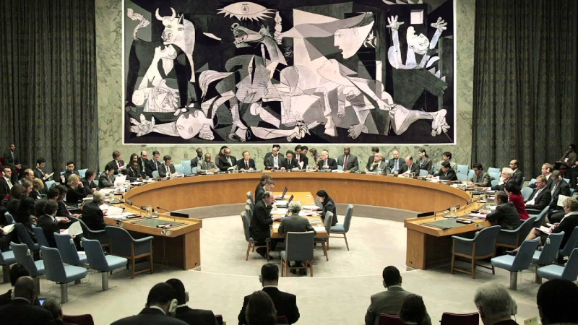
Guernica (1955), tapestry based on Pablo Piccasso’s Guernica (1937) by Jacqueline de la Baume Dürrbach, René Dürrbach

Slide 22
Who’s Afraid of Virginia Woolf?
Picasso’s Guernica had to be covered because it reveals the truth of war, an inconvenient fact on the eve of the Iraq War (2003).
Culture can be dangerous because it speaks truth to power.
In order to be able to understand the full implications and significance of culture, we need to examine it using an interdisciplinary lens, in its material context.

Slide 23
“—Try to be one of us, repeated Davin. In your heart you are an Irishman but your pride is too powerful.
—My ancestors threw off their language and took another, Stephen said. They allowed a handful of foreigners to subject them. Do you fancy I am going to pay in my own life and person debts they made? What for?
—For our freedom, said Davin.
—No honourable and sincere man, said Stephen, has given up to you his life and his youth and his affections from the days of Tone to those of Parnell but you sold him to the enemy or failed him in need or reviled him and left him for another. And you invite me to be one of you. I’d see you damned first.
—They died for their ideals, Stevie, said Davin. Our day will come yet, believe me.

Slide 24
Stephen, following his own thought, was silent for an instant.
—The soul is born, he said vaguely, first in those moments I told you of. It has a slow and dark birth, more mysterious than the birth of the body. When the soul of a man is born in this country there are nets flung at it to hold it back from flight. You talk to me of nationality, language, religion. I shall try to fly by those nets.
Davin knocked the ashes from his pipe.
—Too deep for me, Stevie, he said. But a man’s country comes first. Ireland first, Stevie. You can be a poet or mystic after.
—Do you know what Ireland is? asked Stephen with cold violence. Ireland is the old sow that eats her farrow.”
James Joyce, Portrait of the Artist as a Young Man (1916)

Slide 25
“Why, you know Sir Thomas’s means will be rather straitened, if the Antigua estate is to make such poor returns!”
- Jane Austen, Mansfield Park (1814)

